Slide 1
Wildfire
Corsican Data EDA
Alina Zheng, Faith A Dennis, Derrick Ng

Slide 2
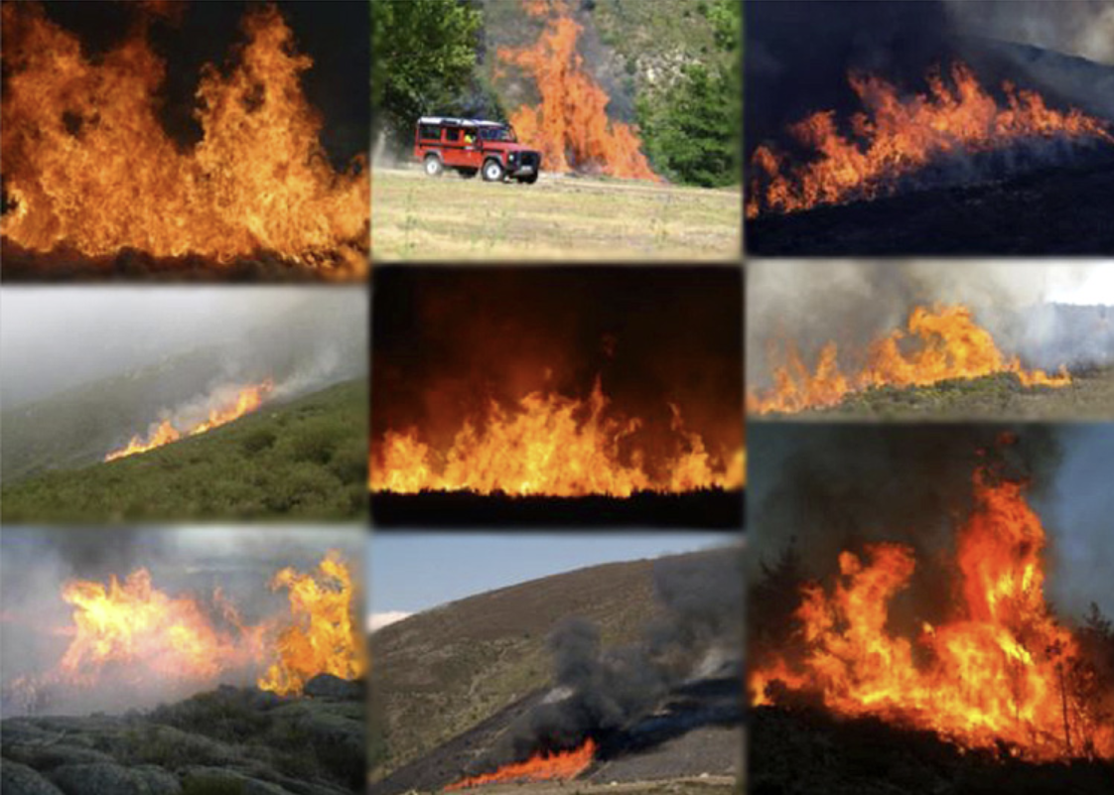
About
Purpose:
A standard, multifaceted dataset of wildfire images and videos for researchers
Contents:
500 RGB images
100 RGB + IR images
Sequential images are duplicated and prefaced with "seq"
Each image has a corresponding ground truth
22 descriptors
autogenerated by software or provided manually by photo owners
Images from the CFDB. Website: https://cfdb.univ-corse.fr/

Slide 3
Contents
EDA on CSV data
Preprocessing uncleaned data
Summary statistics
Sparsity analysis
Visualizing distributions
Image Exploration
Random sampling across dataset
Category specific sampling
t-SNE analysis
Recommendations / Future Directions

Slide 4
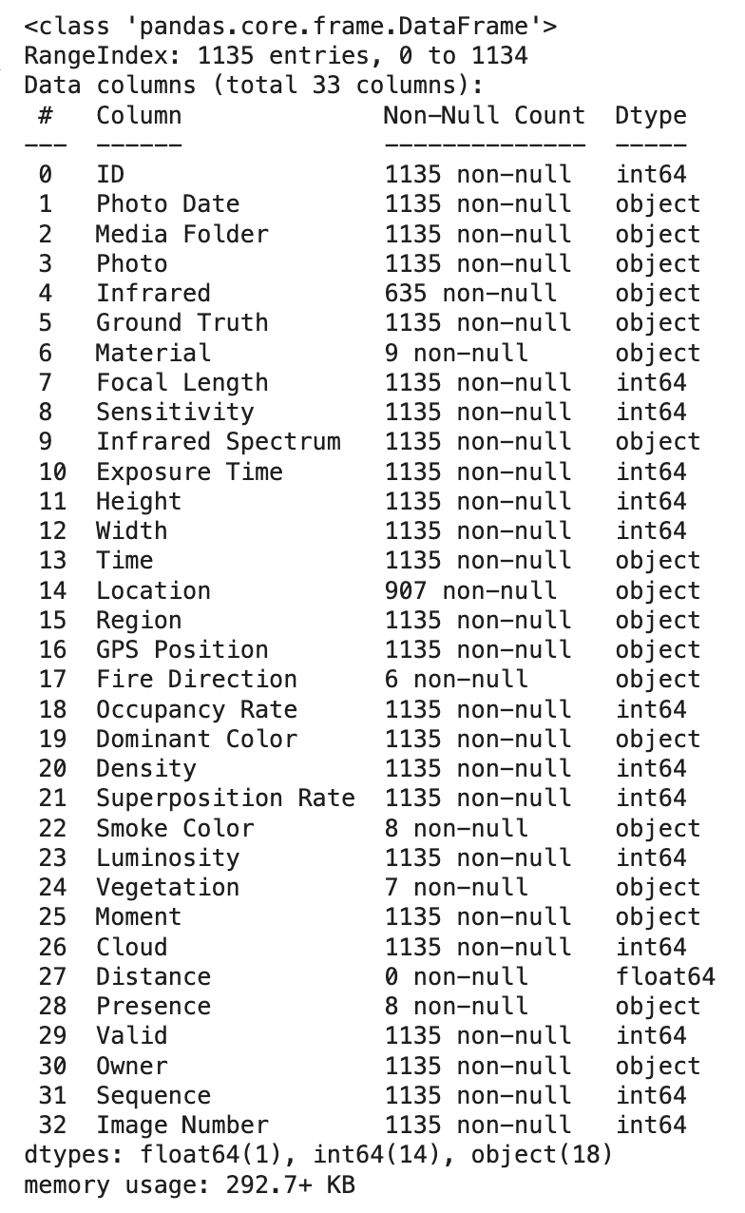
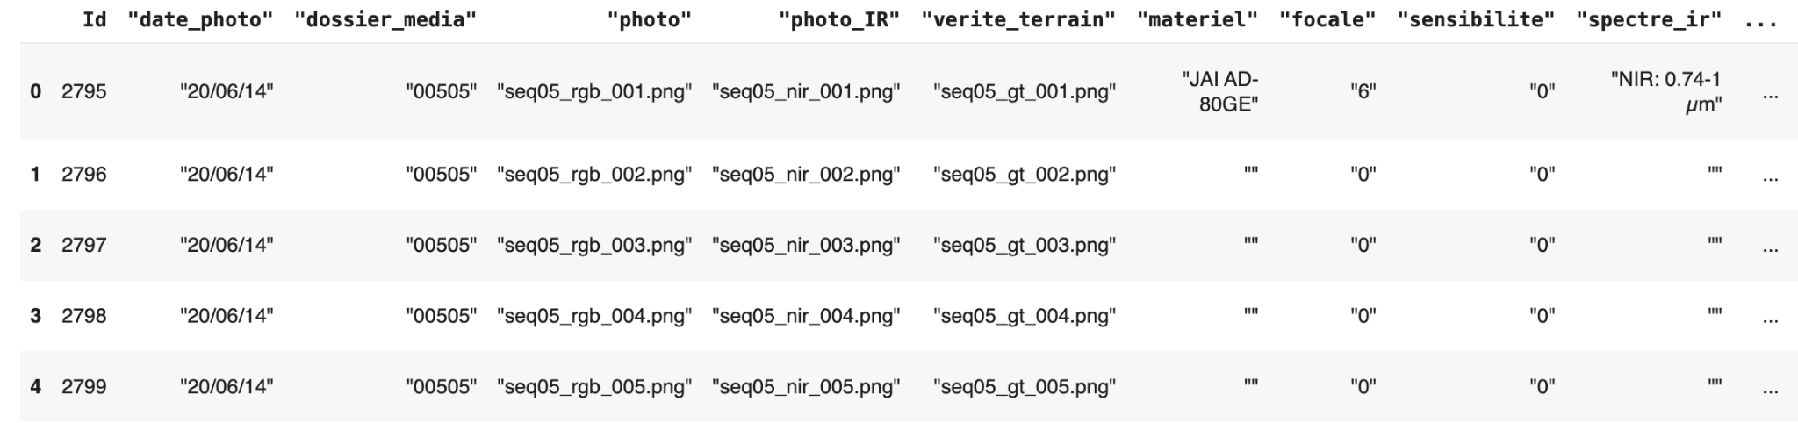
Preprocessing
Original columns were in French: French -> English
Unwanted characters (‘, ‘’, ) were stripped from the data
Relevant strings (English translations) were extracted from the data
Data transformation: Converted str to int
Most global descriptors have no null values
Several descriptors such as Fire Direction, Smoke Color, Vegetation, and Presence contain very limited information

Slide 5
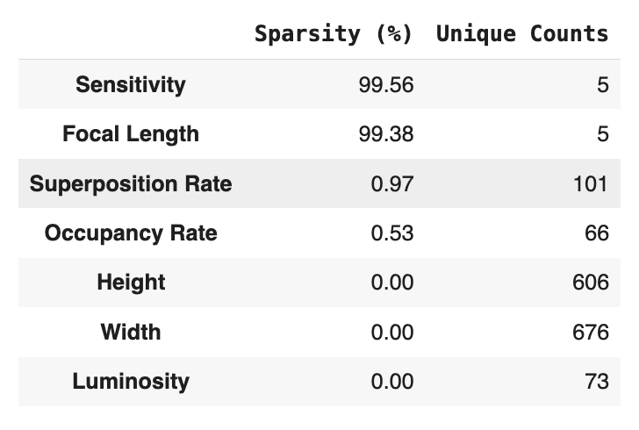
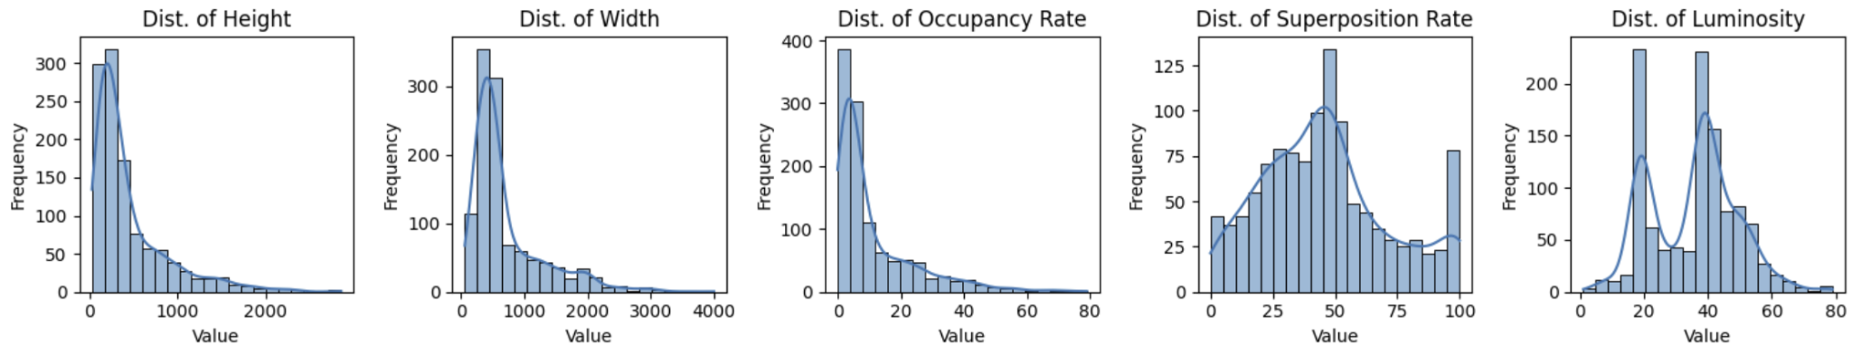
Summary Statistics
Numerical descriptors are primarily image metadata.
Focal Length and Sensitivity are manually provided by image owners
<1% available.
Other numerical categories are widely available.
>99% available
Occupancy rate and superposition are computer generated and could be further investigated to determine accuracy and imputability.
Sparsity analysis of numerical descriptors
Distribution of numerical descriptors

Slide 6
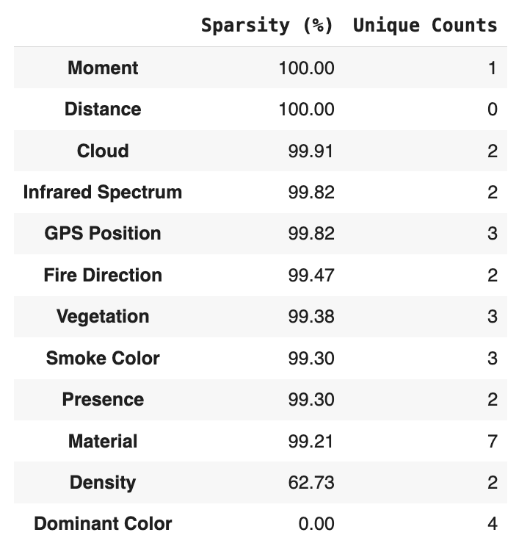
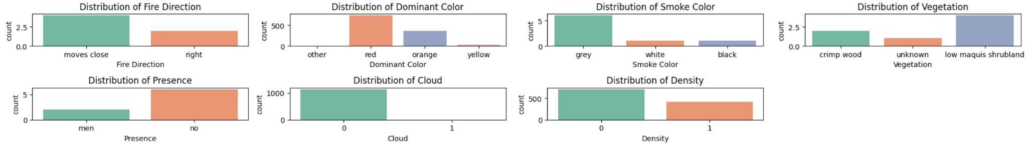
Summary Statistics
Sparsity analysis of categorical descriptors
Categorical descriptors consist of fire descriptors and metadata about the image
Limited # of categories per most descriptors
Imbalance between categories
Majority of categorical descriptors are sparse
<1% availability
Material, Infrared Spectrum, and GPS position are metadata about the camera provided by the owner.
Cloud and Density are binary descriptors that do not accurately reflect sparsity
Further investigation is needed to determine whether the rest of the values can be imputed*
Distribution of categorical descriptors
*Annotation Guideline

Slide 7
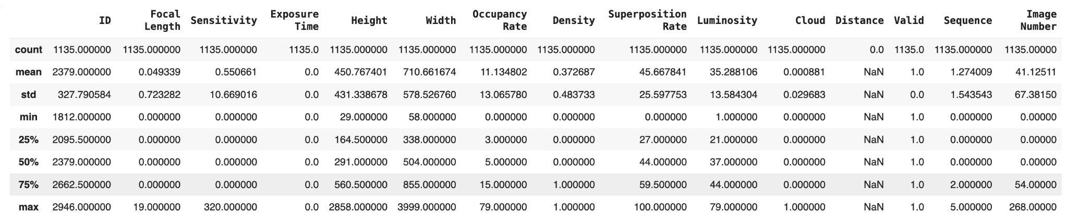
Summary Statistics
Reference of summary statistics for numerical values
Notes:
Height & Width
Occupancy Rate
Luminosity
Distance

Slide 8
Correlation Analysis
Why Correlation Matters in Wildfire Analysis:
Helps identify how fire characteristics (color, smoke, size, brightness) relate to each other.
Provides insights into what factors influence fire visibility, which is crucial for developing reliable fire detection models.
Types of Correlations Explored:
Numerical Feature Correlations (e.g., occupancy, luminosity, superposition).
Categorical-Numerical Feature Correlations (e.g., fire color vs. fire size).

Slide 9
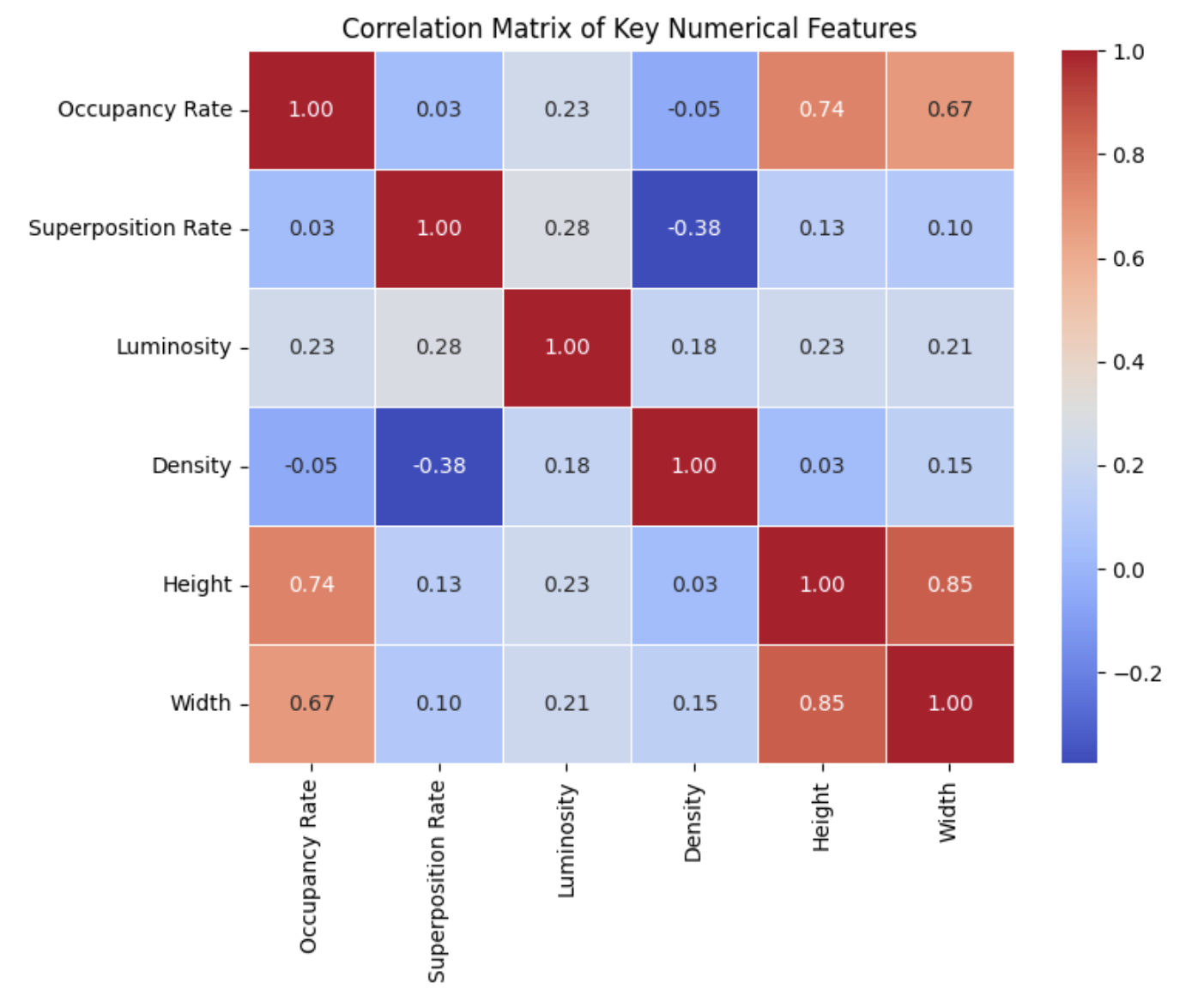
Correlation Matrix of Key Numerical Features
Brightness as a fire indicator:
Luminosity correlates with occupancy (0.23) and superposition (0.28), indicating brighter fires tend to be larger and more affected by smoke.
This implies that brightness alone is not always a reliable measure of fire intensity and should be analyzed alongside other factors.
Smoke affects fire visibility:
Superposition and density are negatively correlated (-0.38), meaning thicker smoke reduces visible fire pixel density.
This suggests higher superposition may degrade segmentation accuracy, requiring infrared fusion techniques.

Slide 10
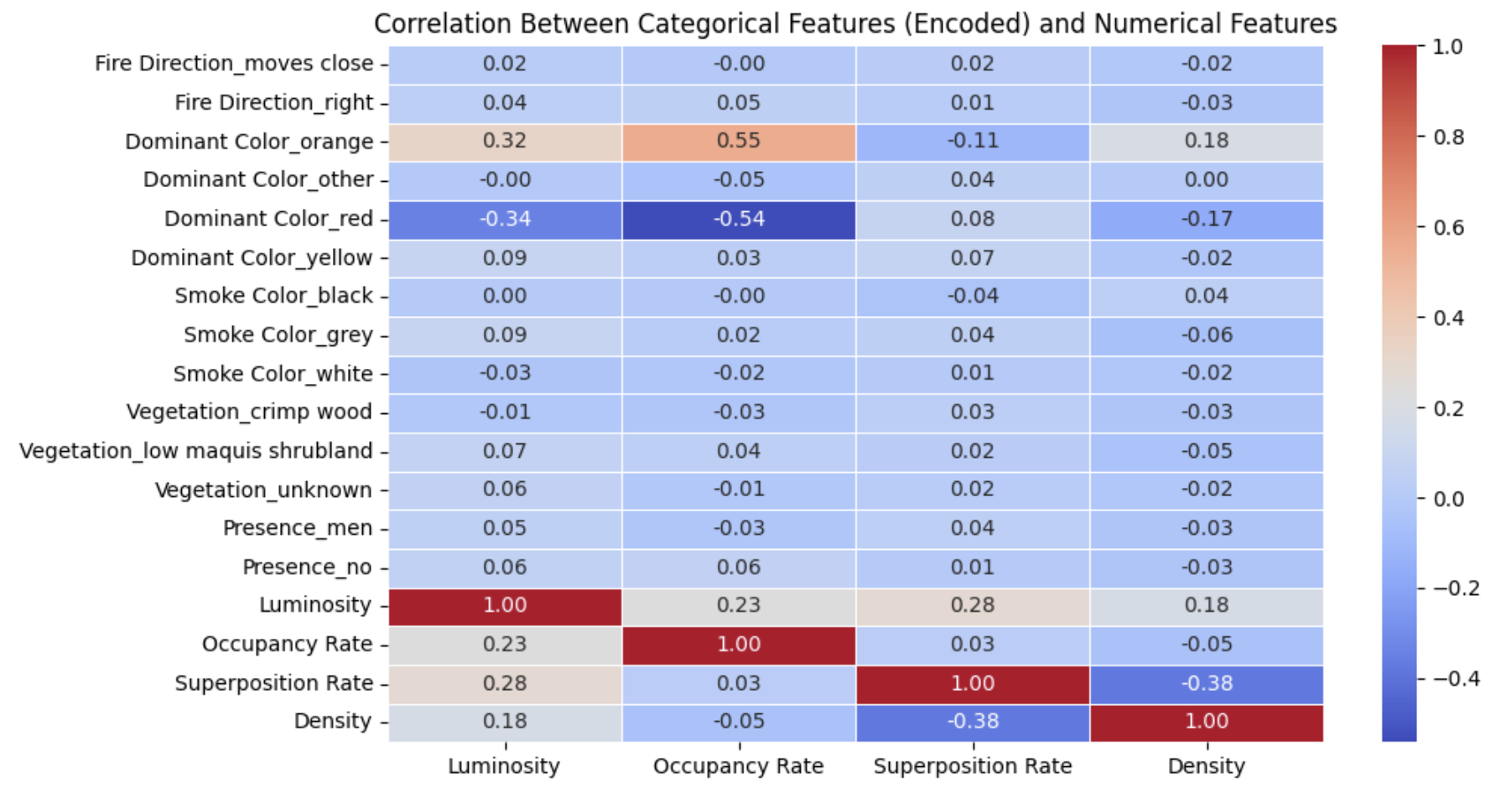
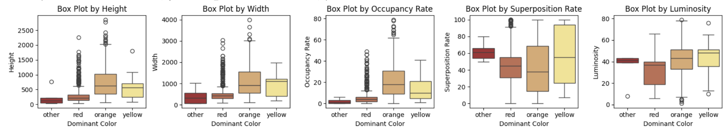
Correlation Between Categorical Features
and Numerical Features
Orange fires are the most widespread and brightest:
Strong correlation between orange fire and occupancy (0.32) and luminosity (0.55)
Red fires tend to occupy less image space (more localized):
The negative correlation between red fire and occupancy (-0.54) suggests that red fires cover a smaller area within the images.
Vegetation type has little correlation with fire characteristics:
Weak correlations between vegetation and fire properties
Terrain may be a secondary factor in fire spread.

Slide 11
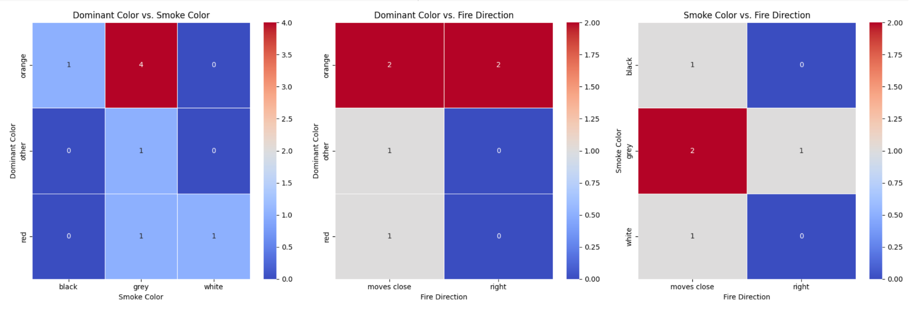
Correlation Between Categorical Features
These heatmaps display the co-occurrence between fire color, smoke color, and fire movement direction.
The observed co-occurrences may not be fully representative due to data sparsity. Some relationships may appear stronger simply because of limited samples in certain categories, rather than indicating a true underlying pattern.

Slide 12
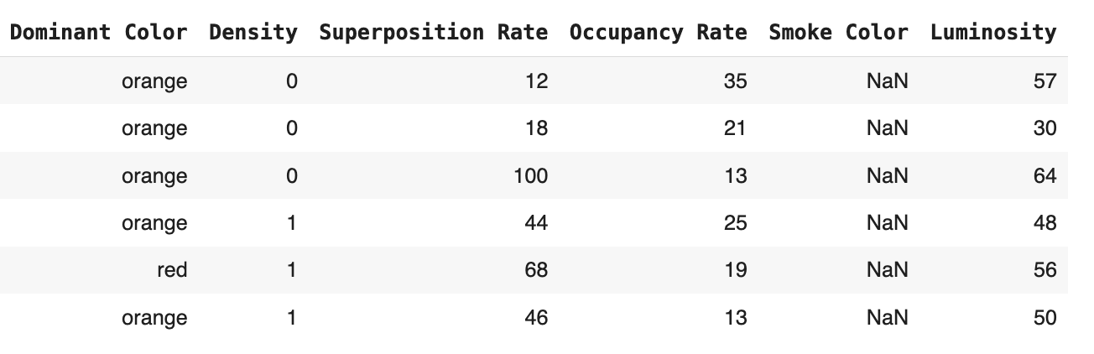
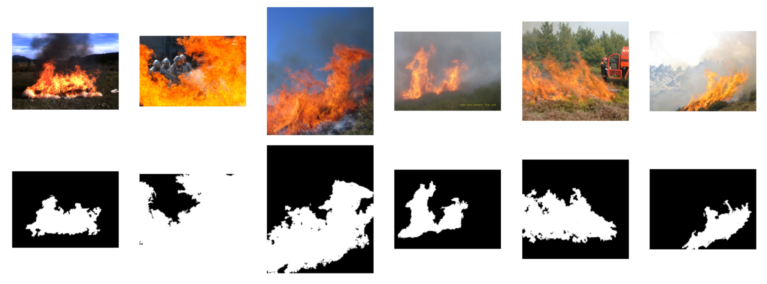
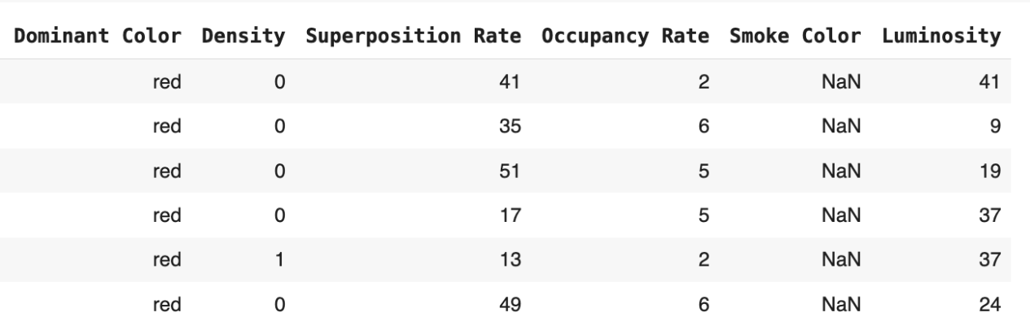
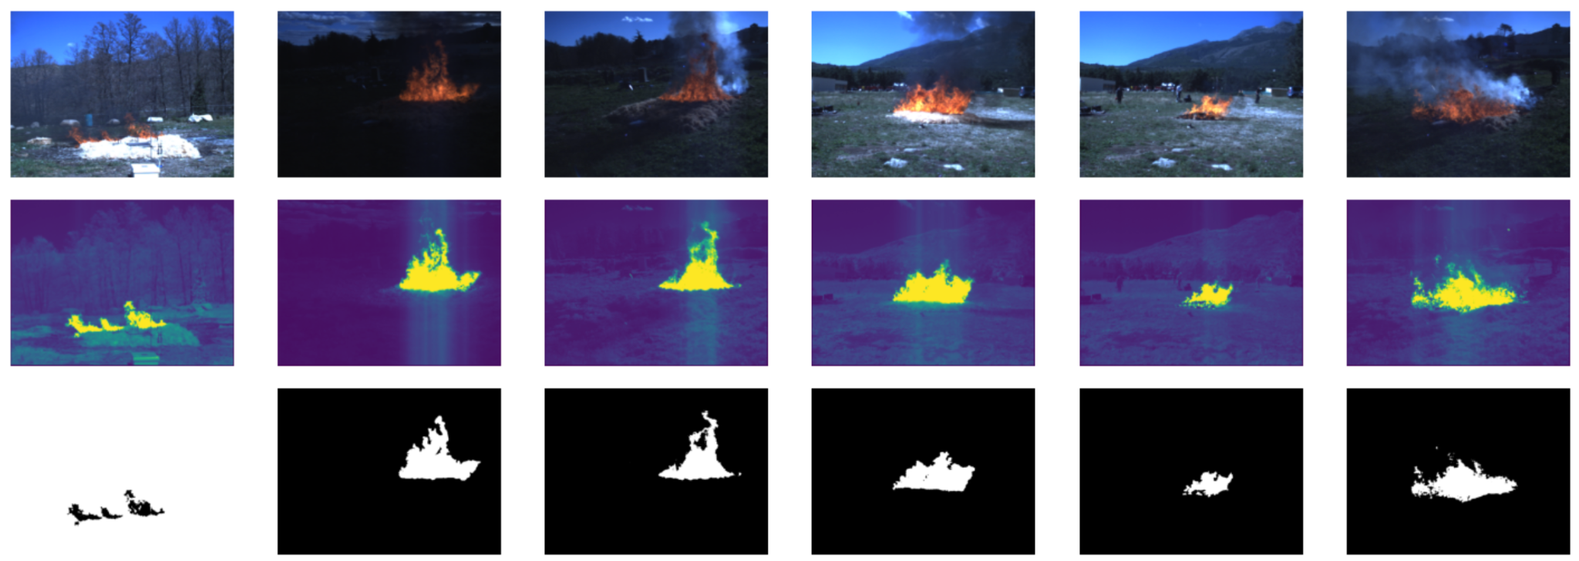
Random Image Sampling
Descriptors of a random sample of RGB images across the entire dataset
Corresponding RGB images and their ground truths
Descriptors of RGB images with corresponding IR images
Corresponding RGB, IR, and ground truth images

Slide 13
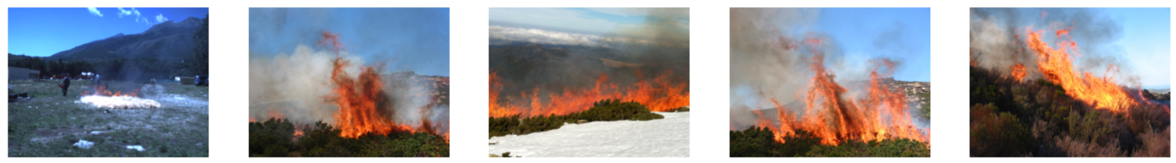
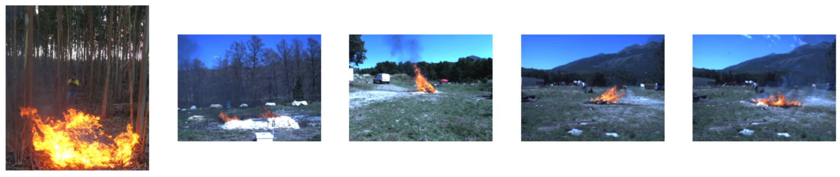
Random Image Sampling
Infrared images are homogenous in environment, lighting, and fire color. They show limited variation.
Superposition and occupancy do not reliably align with visual observations of smoke coverage over the fire.
Possible error obtained through the processing step
Not enough labeled images with other smoke colors are available to randomly sample
Density as an indicator of fire texture appears to correlate with fires with a high degree of variability in color
Limited variation in distance taken.
RGB images where Smoke Color is "grey"
RGB images where Density is 1

Slide 14
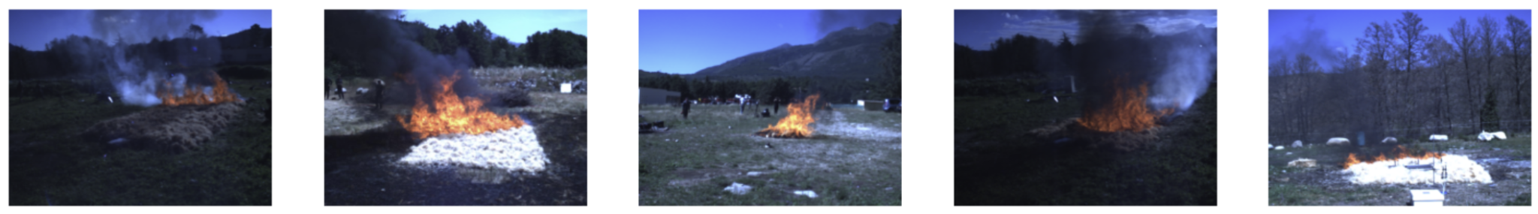
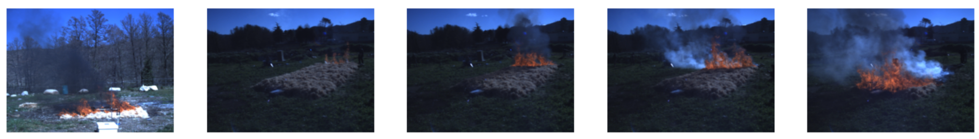
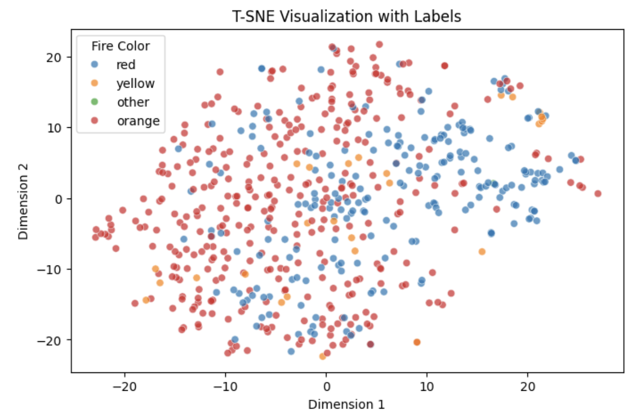
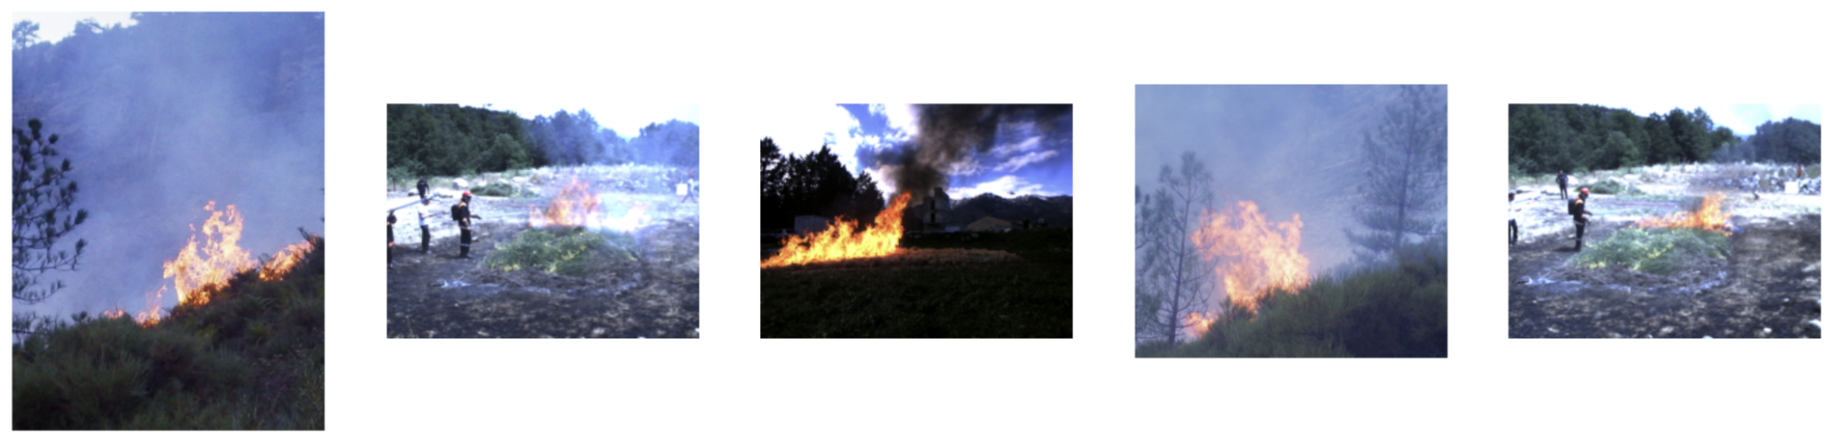
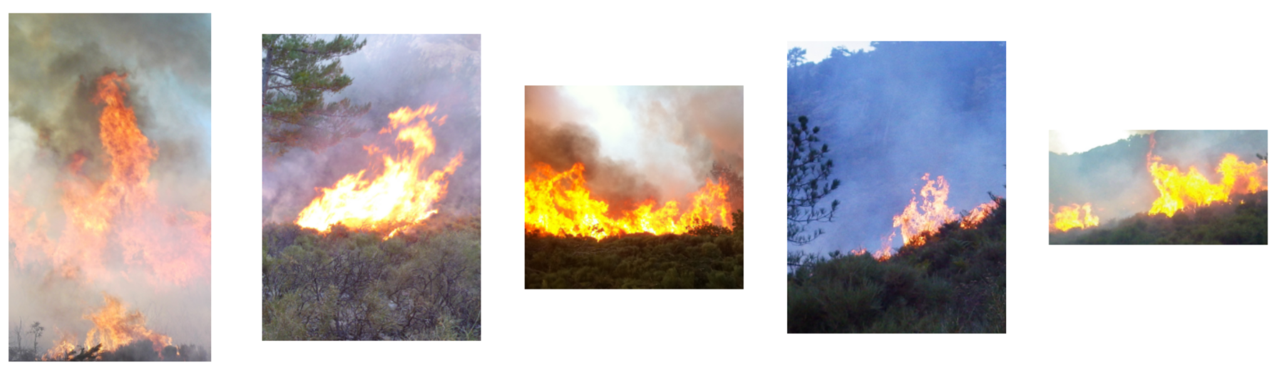
Dominant Fire Color Samples and t-SNE
Dominant fire color labels appear to be subtle, difficult to distinguish by eye
Lack of strong clustering in t-SNE indicates images don’t have distinctive features separating them
Noise
RGB images where dominant color is "red"
RGB images where dominant color is "yellow"

Slide 15

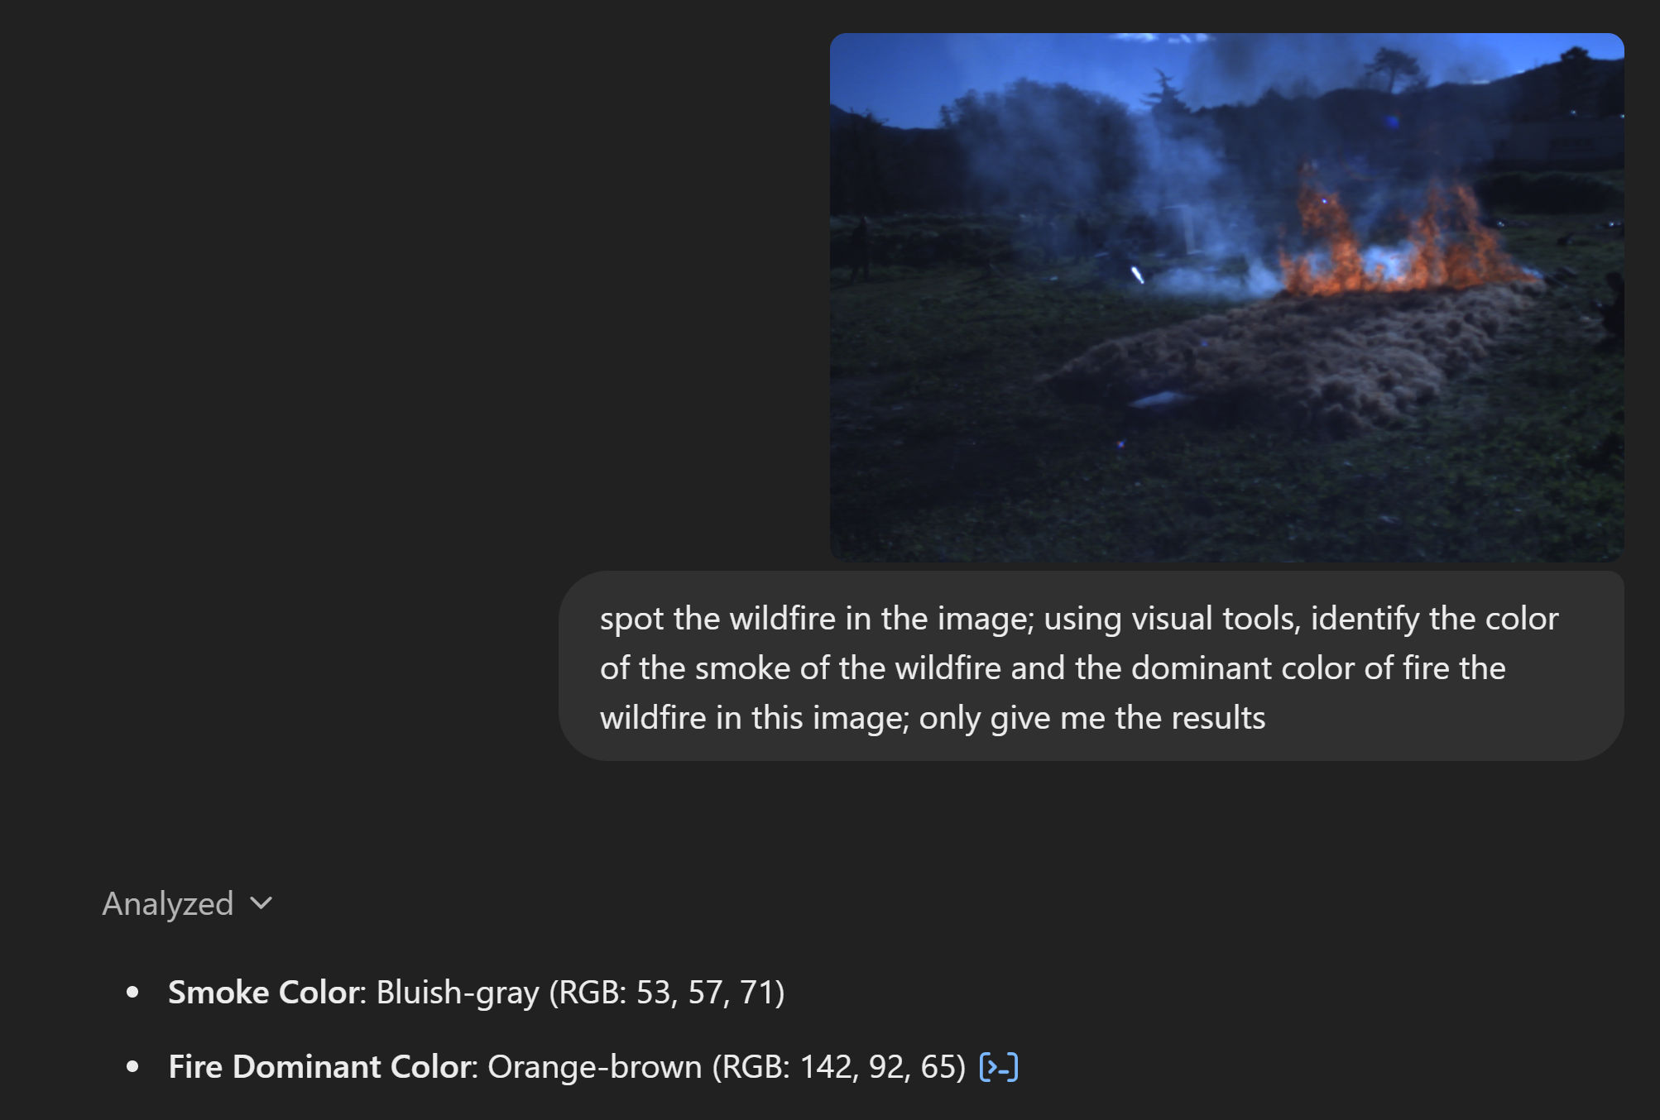
Future Directions
Addressing Data Sparsity: Use GPT-4 Vision or similar models to impute missing descriptors, evaluating accuracy and impact on downstream tasks.
Expanding Dataset Variability: Increase low-light, distance, and terrain diversity in RGB + IR images to enhance model generalization and reduce bias.
Improving Smoke and Fire Differentiation: Enhance superposition and occupancy calculations with multi-modal segmentation (RGB + IR fusion) for better fire detection.
Temporal Fire Analysis: Assess how sequential RGB + IR images generalize across fire conditions using LSTMs or Transformers for wildfire progression modeling.
Testing Model Generalization: Benchmark pretrained models (Vision Transformers, YOLO, EfficientNet) to evaluate robustness across diverse fire descriptors and conditions.
Screenshot using GPT to provide smoke and dominant fire color descriptions given an image

